Slide 1
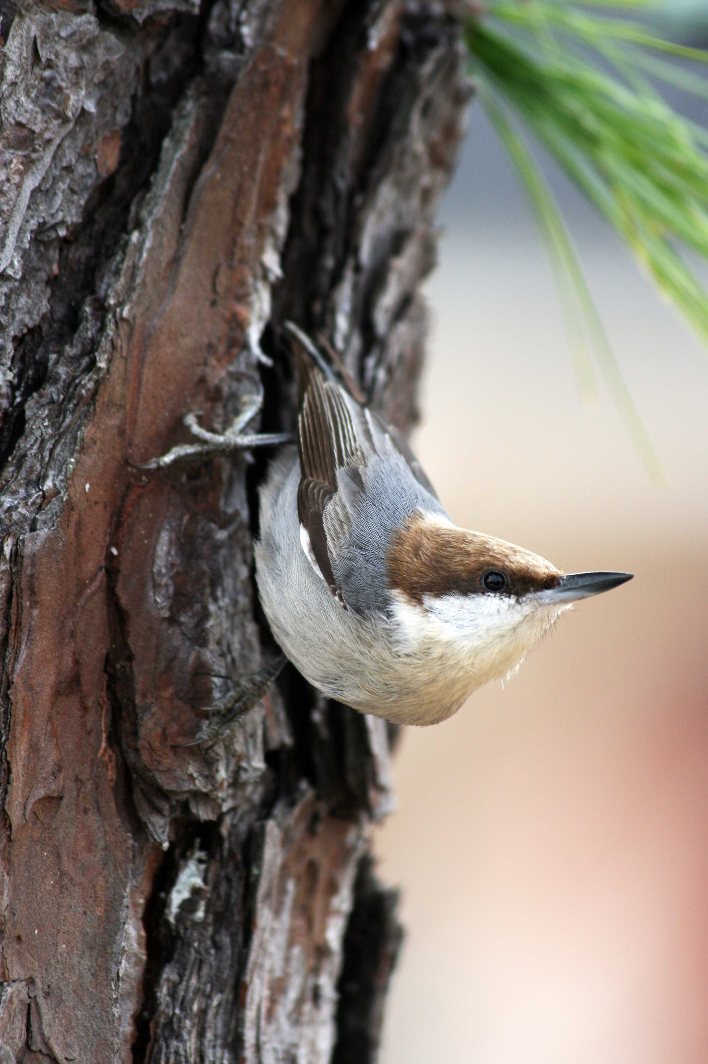
Audubon’s Climate Watch
A Bird and climate change community science collaboration
Notes:
This slide show is an overview of Audubon’s Climate Watch program, a collaboration between Audubon scientists and community science volunteers to test our predictions about how birds are responding to climate change.

Slide 2
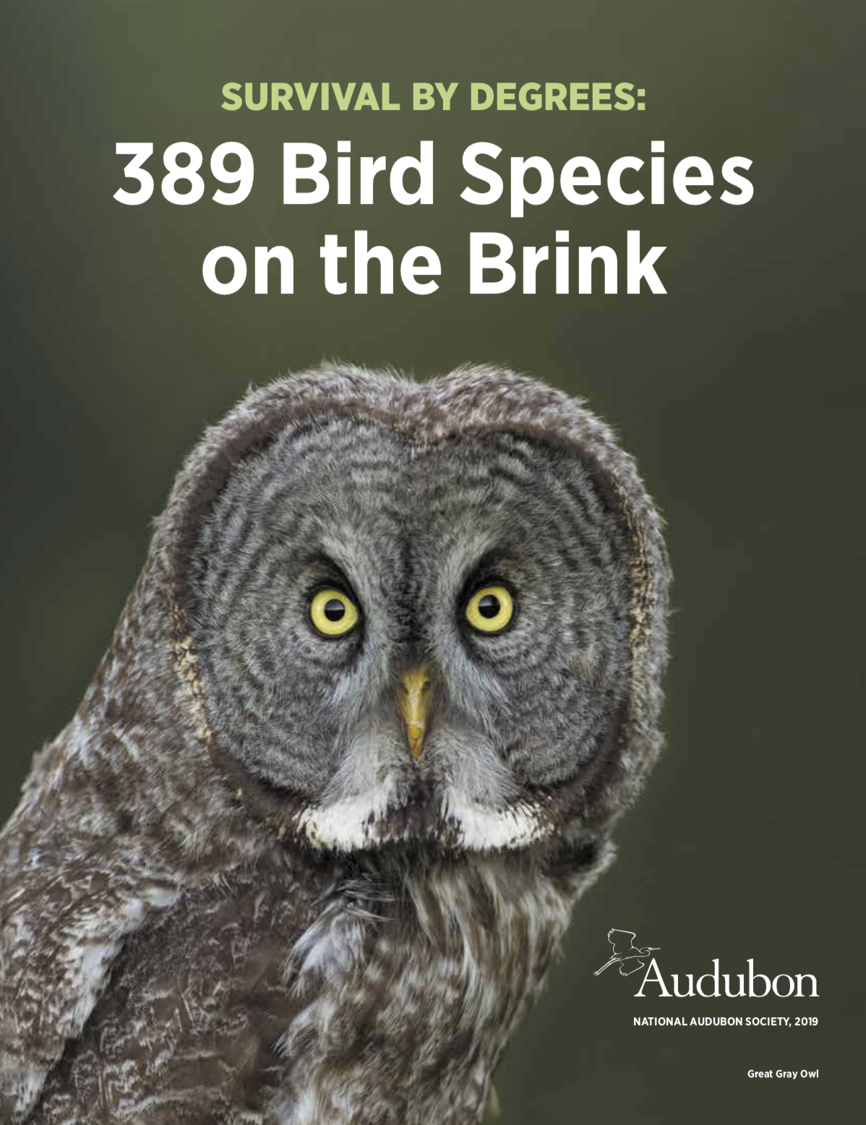
SURVIVAL BY DEGREES:
389 Bird Species on the Brink
Notes:
In 2019 we released our report Survival by Degrees. Audubon’s new science shows that two-thirds (64%) (389 out of 604) of North American bird species are at risk of extinction from climate change.
Two papers where published in Conservation Science and Practice the journal of the Society for Conservation Biology. Both papers were officially published in July 2020 (pre-prints available in 2019). You can read the climate-change analysis here and the climate threats analysis here.
Our methodology in Survival by Degrees is the same peer-reviewed methodology used for our North American Grasslands & Birds Report published earlier in 2019.
Bateman BL, Wilsey C,Taylor L, Wu J, LeBaron GS, Langham G. North American birds require mitigation and adaptation to reduce vulnerability to climate change. Conservation Science and Practice. 2020;2:e242.https://doi.org/10.1111/csp2.24218 of 18BATEMANET AL.
Bateman BL, Taylor L,Wilsey C, Wu J, LeBaron GS, Langham G. Risk to North American birds from climate change-related threats. Conservation Science and Practice. 2020;2:e243.https://doi.org/10.1111/csp2.243BATEMANET AL.

Slide 3
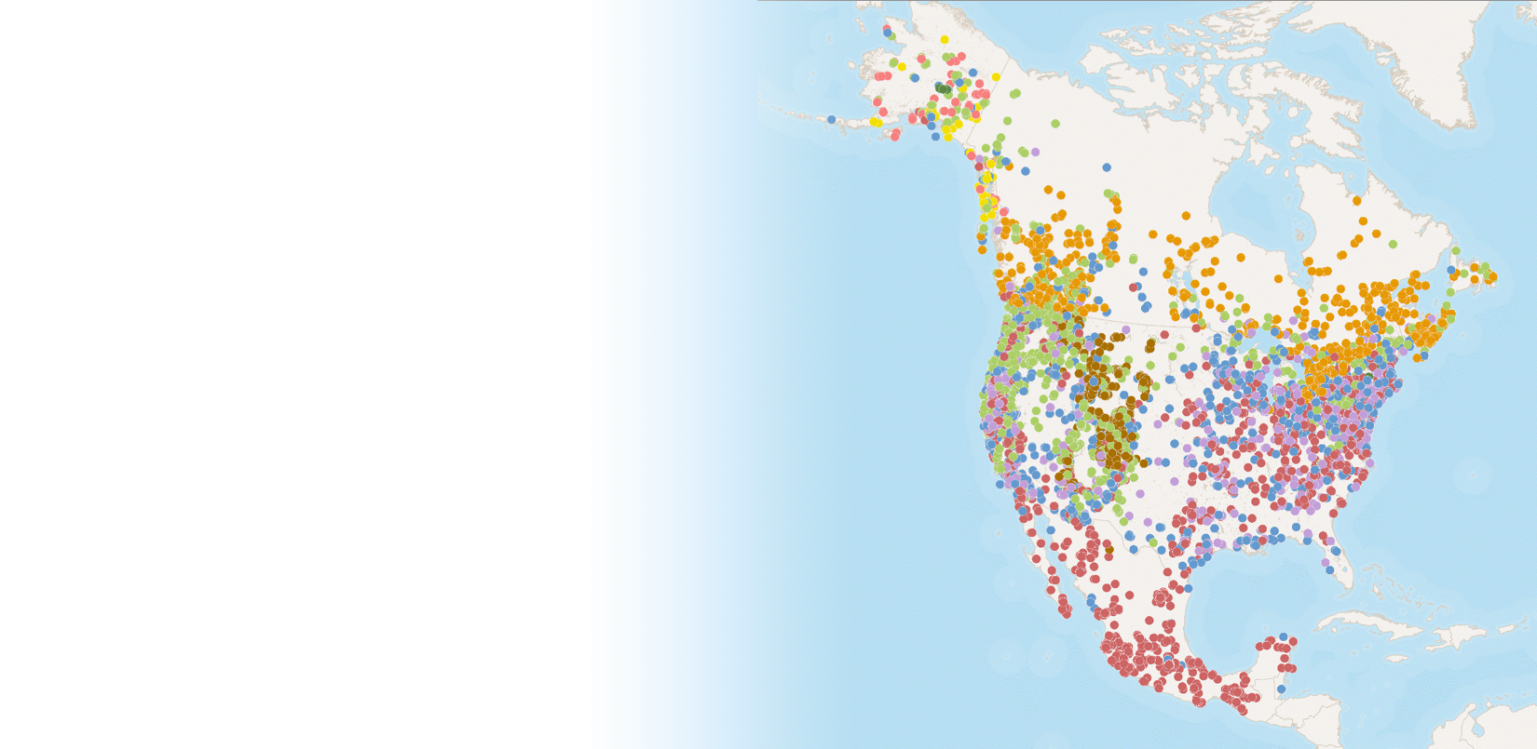
Robust Data
140+ million observations
70+ data sources
No one has assembled a larger dataset of bird observations for North America, from as many diverse sources to assess the impacts of climate change on birds
Notes:
Audubon scientists studied 604 North American bird species using 140 million bird records—including observational data from bird lovers across the country. We plugged our bird data into the same climate models used by more than 800 experts in 80 countries to map where each bird might live in the future under a changing climate. We used over 70 data sources and 140+ million bird records were used in the analysis. Sources include eBird, U.S. Geological Survey, North American Breeding Bird Survey, and Global Biodiversity Information Facility.

Slide 4
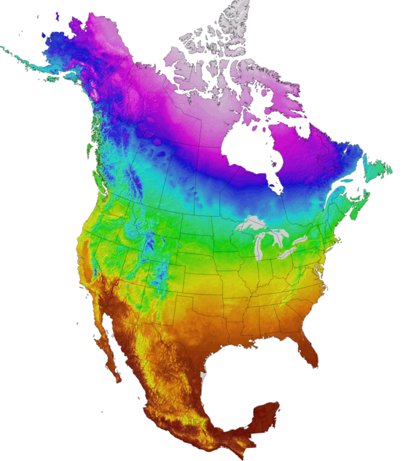
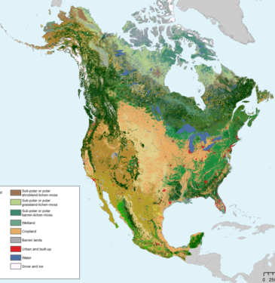
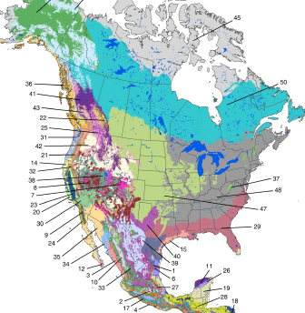
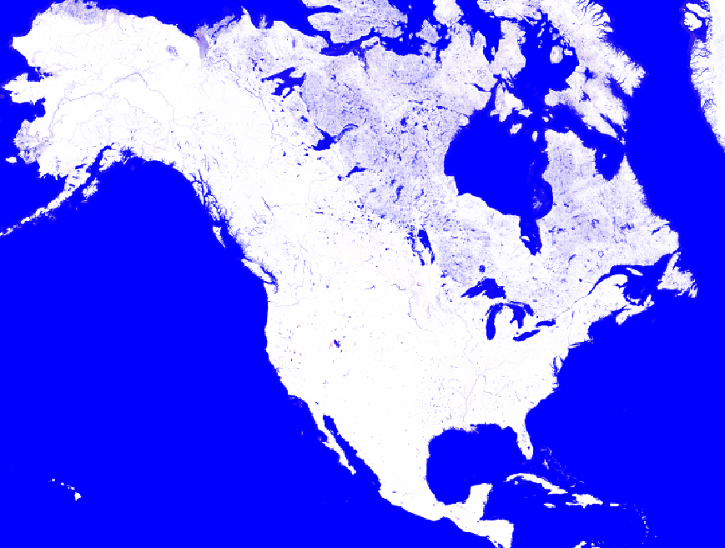
New science; what’s in Audubon’s climate model?
Climate
Human Land Use
Vegetation Change
Group-specific Variables
Notes:
We also took extra care with each species and its ecology.
Our models look at the most fundamental climate and vegetation needs each species requires for survival; This included:
Climate modeling based on 2014 IPCC (International Panel on Climate Change) Fifth Assessment Report models for 1.5, 2.0, and 3.0 degrees C of global warming.
the climate data are from a report of international panel of more than 800 climate change experts called the Intergovernmental Panel on Climate Change Fifth Assessment Report. The models are based on CMIP5 data from the AR5—IPCC 5th assessment. More specifically, Adaptwest’s downscaled North American data, ClimateNA.
Uses data for North America, including Mexico.
1 kilometer resolution allows for a fine level of mapping detail for both winter and summer seasons.
Each bird species was modeled by an associated habitat group, and we included group-specific variables where it was relevant such like global surface water for waterbirds and other water associated species, wetland type for marshbirds, and distance to coastline for our coastal bird species. This also includes:
new variables that are important for birds such as vegetation, human-land use in agriculture and urbanization, as well as group-specific variables (e.g. surface water occurrence). These were not in the 2014 Audubon analysis.
Includes guild-based/habitat-based analysis of bird species, such as grasslands, arctic, boreal, coastal, aridlands, etc., with tailored modeling with specific variables, particularly in summer and winter.

Slide 5
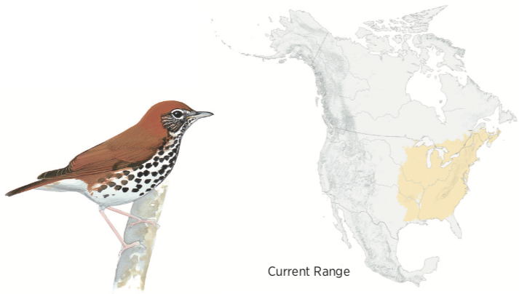
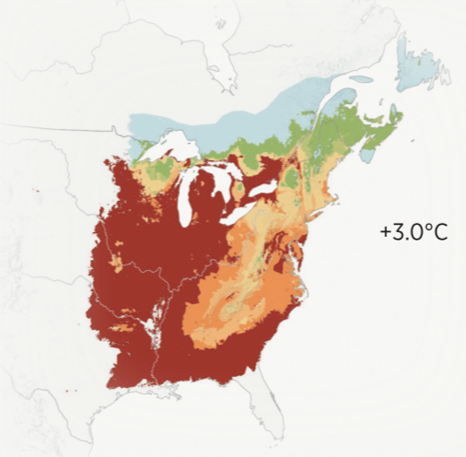
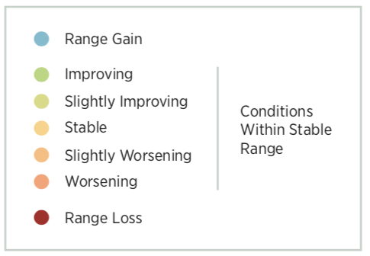
Modeling ranges
projection
Future Range
Wood Thrush
Notes:
For each species in summer and winter, we combined our bird observation data with the environmental data to build a model of that species’ current range. We then had experts review the model and fine-tune any parameters that needed modifying to best capture the full extent of each species’ range.
It wasn't until we were happy with the quality of that model that we then took the latest projections of climate and vegetation (from the previous slide) and predicted into the future where we expect to find suitable climate and habitat for that species. We’re also able to look at not only where is their projected future range loss, but also where we see conditions for that species potentially worsening (orange in these maps), maintaining stability (yellow), or improving over time (green). And then also, where is there a potential for range gain where the species is not found today – indicated by the blue shading. Again, we did these predictions at a one kilometer resolution, which allows our models to be that much more detailed.
In this wood thrush example, you can see that in areas colored in red, where the species is anticipated to lose range where those areas are no longer going to be suitable. A

Slide 6
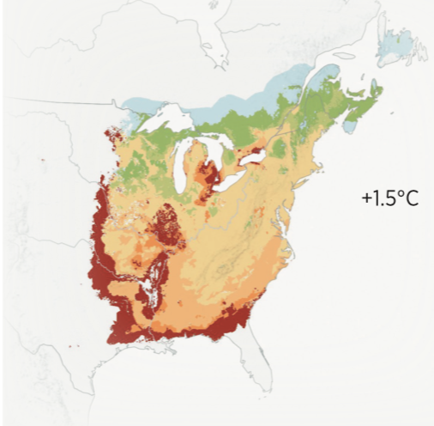
projection
Wood Thrush
Notes:
The scenarios we consider are under each of the two different degree raise in temperature.
What we can see as at three degrees scenario if we continue with business as usual and do nothing about climate change, that the wood thrush is going to be considered highly vulnerable to climate change with a large portion of its range considered no longer suitable. However, if we can stabilize global warming than the majority of the species range will be stable and the species is considered low vulnerability to climate change.
We assessed 604 species in this way, to determine how much range loss and gain each species would face with climate change and assessed each species vulnerability based on this.

Slide 7
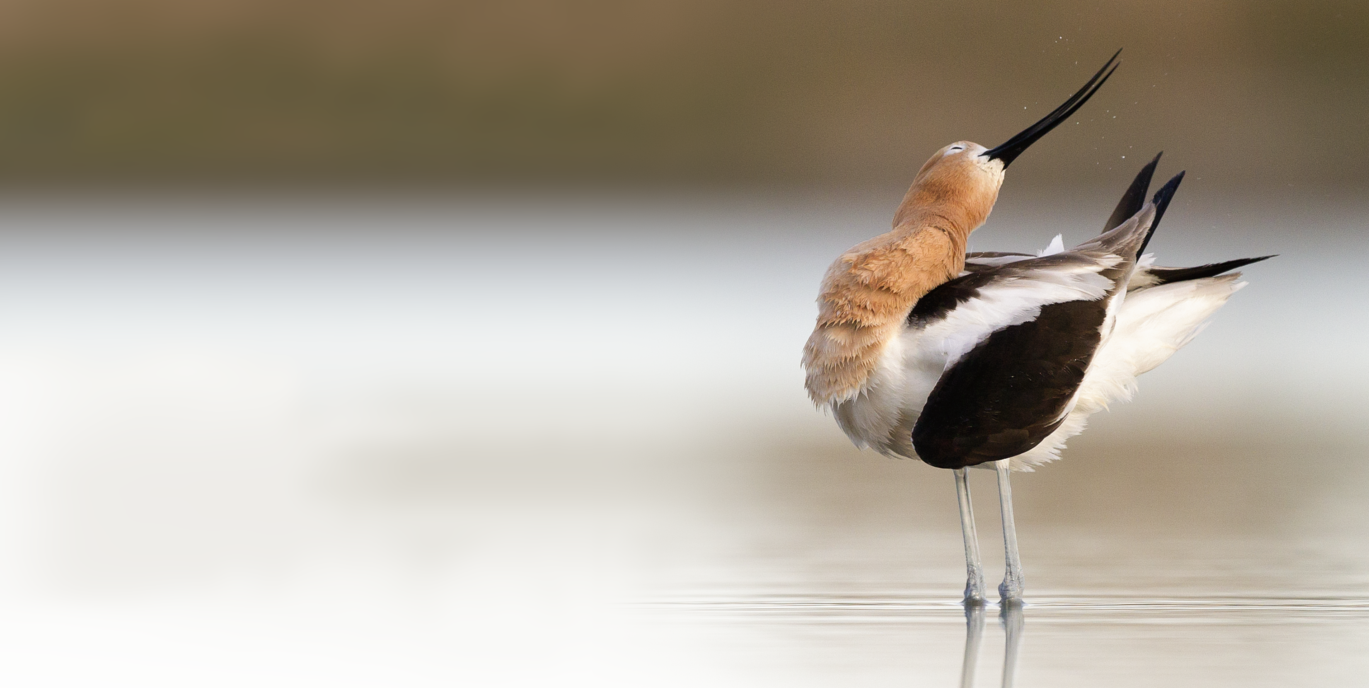
TAKEAWAY
1
Audubon’s new science shows that two-thirds of North American bird species are at risk of extinction from climate change.
American Avocet
Notes:
The first takeaway is that two-thirds of North American bird species are at risk of extinction from climate change.
This project assesses the vulnerability of 604 species to climate change and determined that two-thirds (64%) of the species surveyed are vulnerable to extinction (389 out of 604).

Slide 8
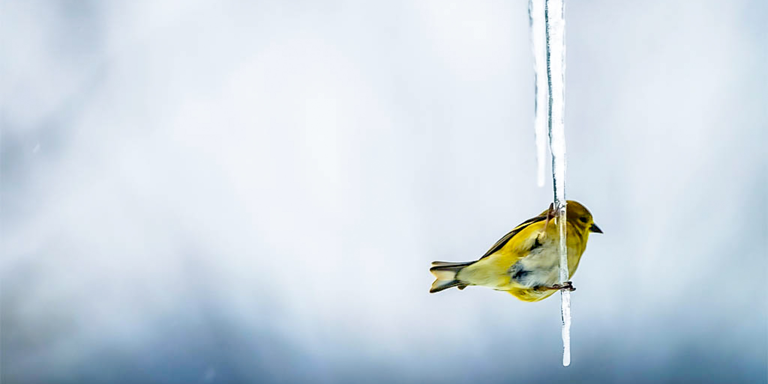
TAKEAWAY
2
The good news is that our science also shows that if we take action now we can help improve the chances for 76% of species at risk.
American Goldfinch
Notes:
The second takeaway, which is good news, is that our science shows that if we take action now we can help improve the changes for 76% of those species at risk. We still have time to act with additional local knowledge.

Slide 9
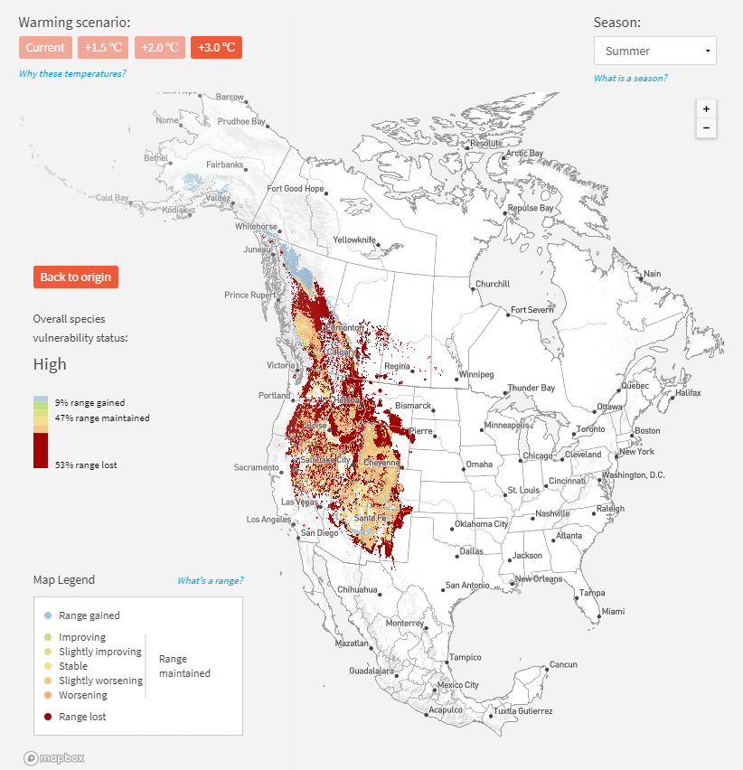
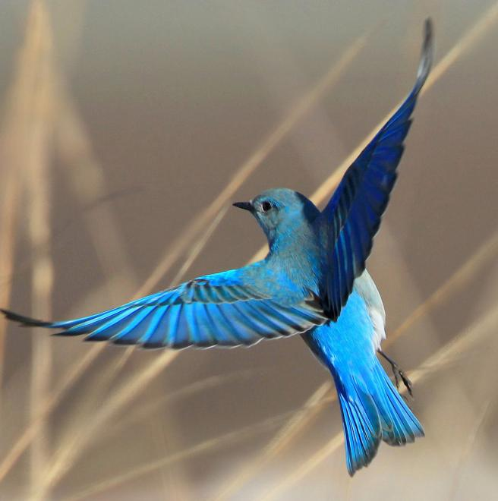
?
Mountain Bluebird
High Climate Vulnerability
Notes:
The individual predictions (what we call “the models”) shown through the animated maps can show a lot of change. Can the birds follow it? Will they follow it? How closely will future ranges match our predictions?
Community science volunteers can help us by ground-truthing our predictions.

Slide 10
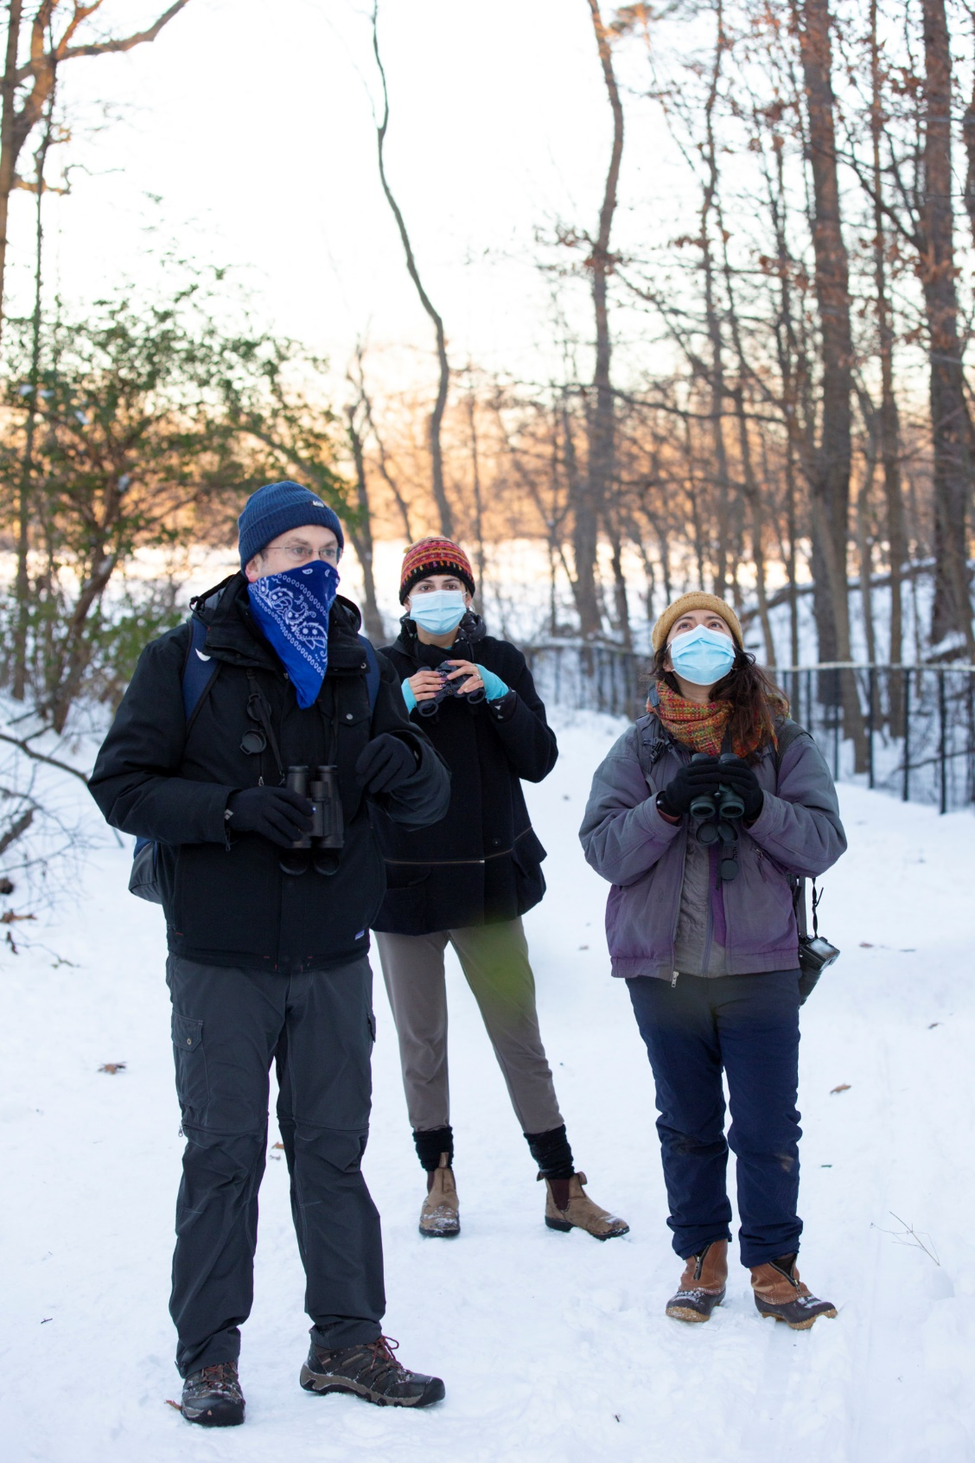
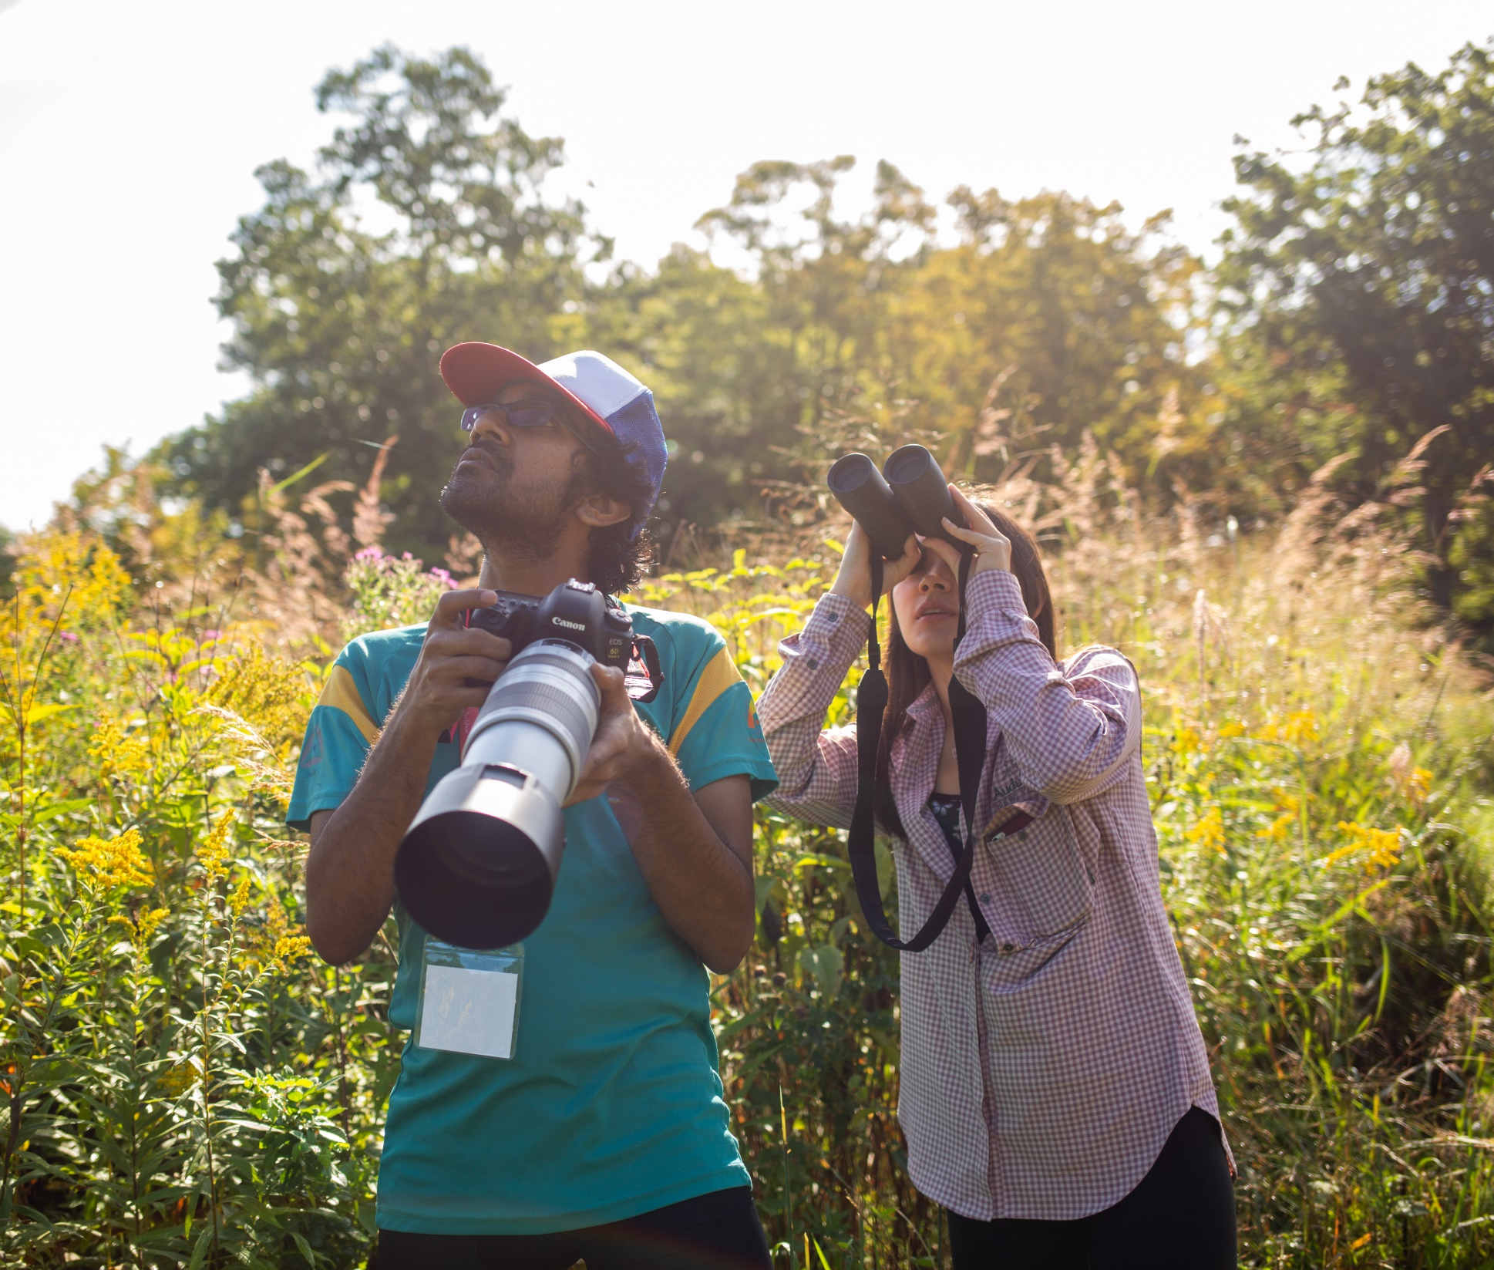
Climate Watch aims to document species’ responses to climate change by having volunteers in the field look for birds where Audubon’s climate models project they should or shouldn’t be in the 2020s.
Notes:
Informing bird monitoring with these climate predictions will both improve our predictions and monitor change on the landscape!
Climate Watch, was developed to document how species are responding to climate change as it is happening by having volunteers in the field look for birds where Audubon’s climate models project they should or shouldn’t be in the 2020s.
In response to Audubon’s Birds and Climate Change report, people asked how they could help make the world a better place for birds. People and nature are intimately entwined, and finding a local, tangible and deeply personal way to help is important.
Audubon’s strength is in our network of people interested in the well-being of birds. Audubon volunteers have been on the forefront of informing the science of bird conservation since the first Christmas Bird Count over 120 years ago.
So we are building on that tradition with the Climate Watch, with a program that allows people to do something meaningful for both the birds they love and taking action on climate change.

Slide 11
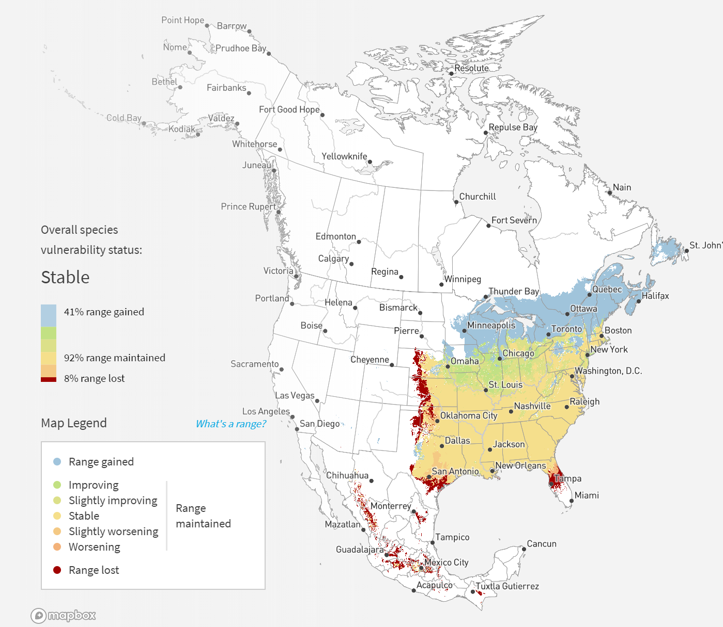
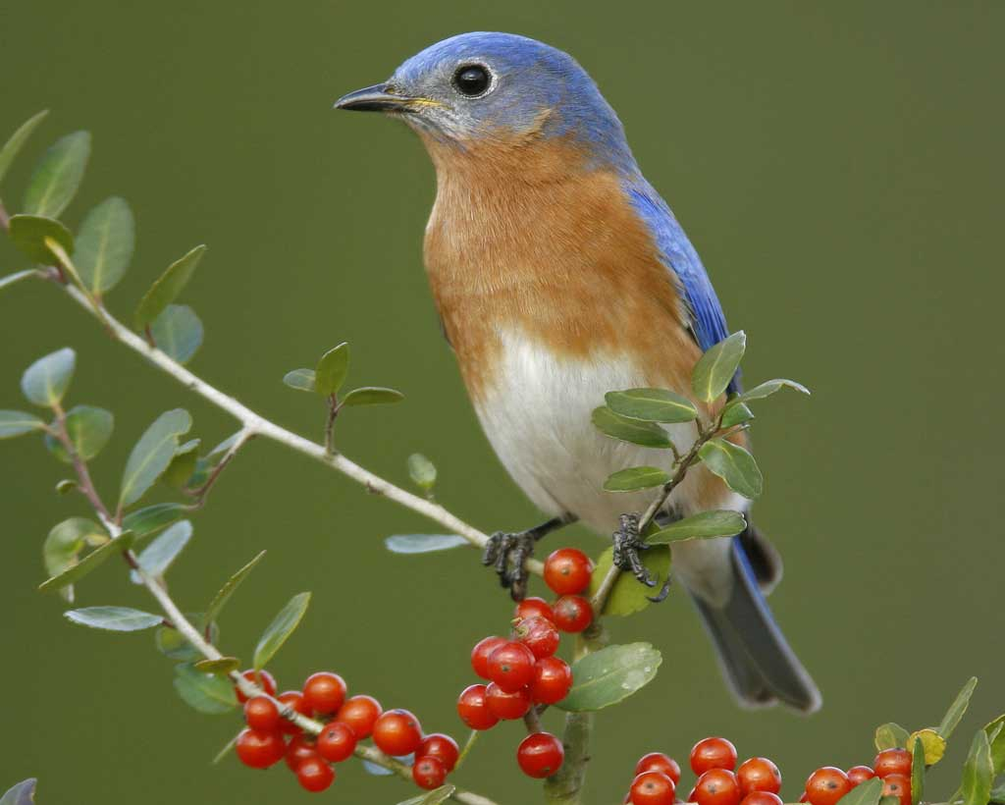
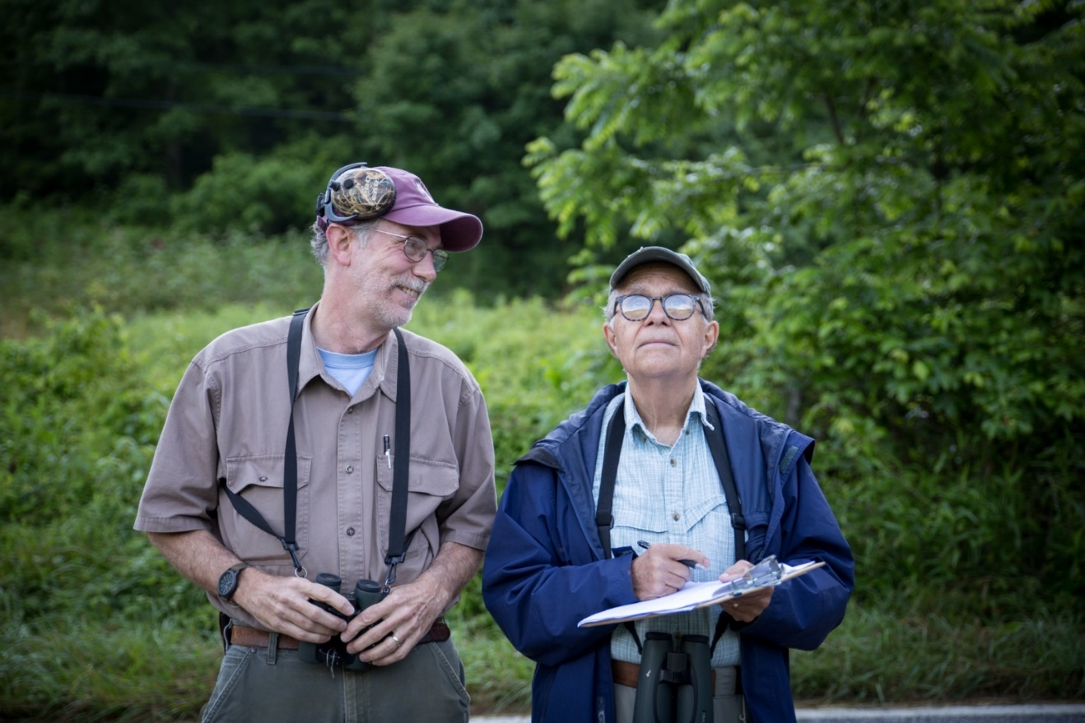
Climate Watch
Science-driven survey and protocol
Monitoring with purpose
Updated models
Hypothesis testing climate change
Improving future projections
Target Species
Good models with strong predictions
Wide geographic coverage
Present in winter and summer
Easily identified, charismatic
Photo: Bran E Small
Photo: Camilla Cerea
Notes:
Climate Watch is a science-driven program in which we ask volunteers to conduct bird surveys using a specific protocol in the field.
This is bird monitoring with a very specific purpose with is testing our individual predictions (“the models”) for 12 species of birds. This is hypothesis testing about climate change. The data collected will then inform our future predictions.
The target species that are the focus of Climate Watch were selected because they have good models with strong predictions for change, they cover a wide geography of the US, they are present in summer and winter and they can be easily identified by volunteers.

Slide 12
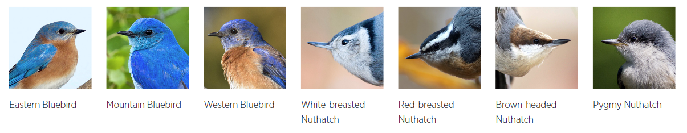
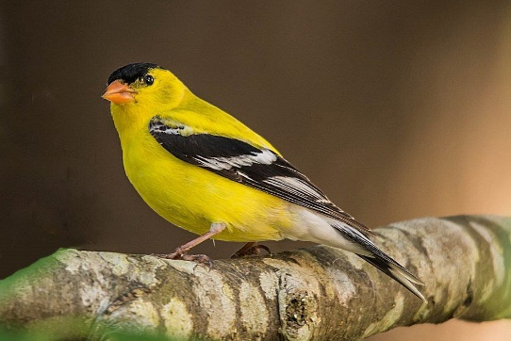
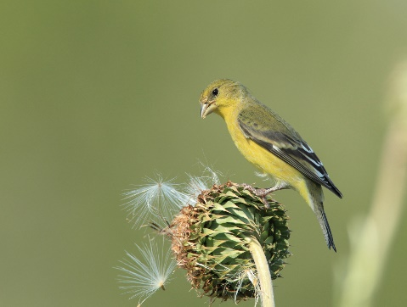
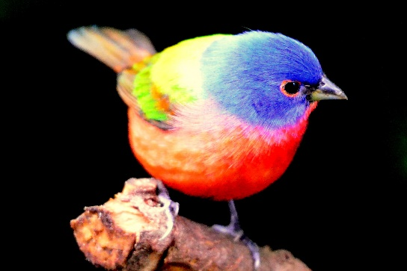
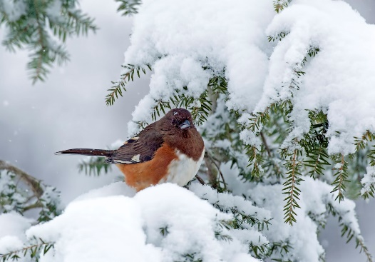
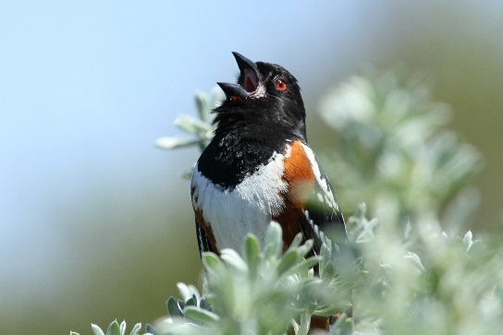
Climate Watch Target Species
American Goldfinch
Lesser Goldfinch
Painted Bunting
Eastern Towhee
Spotted Towhee
Notes:
There are the 12 target species we are studying with Climate Watch: 3 species of bluebirds, 4 species of nuthatch, two species of goldfinch and towhee and Painted Bunting.

Slide 13
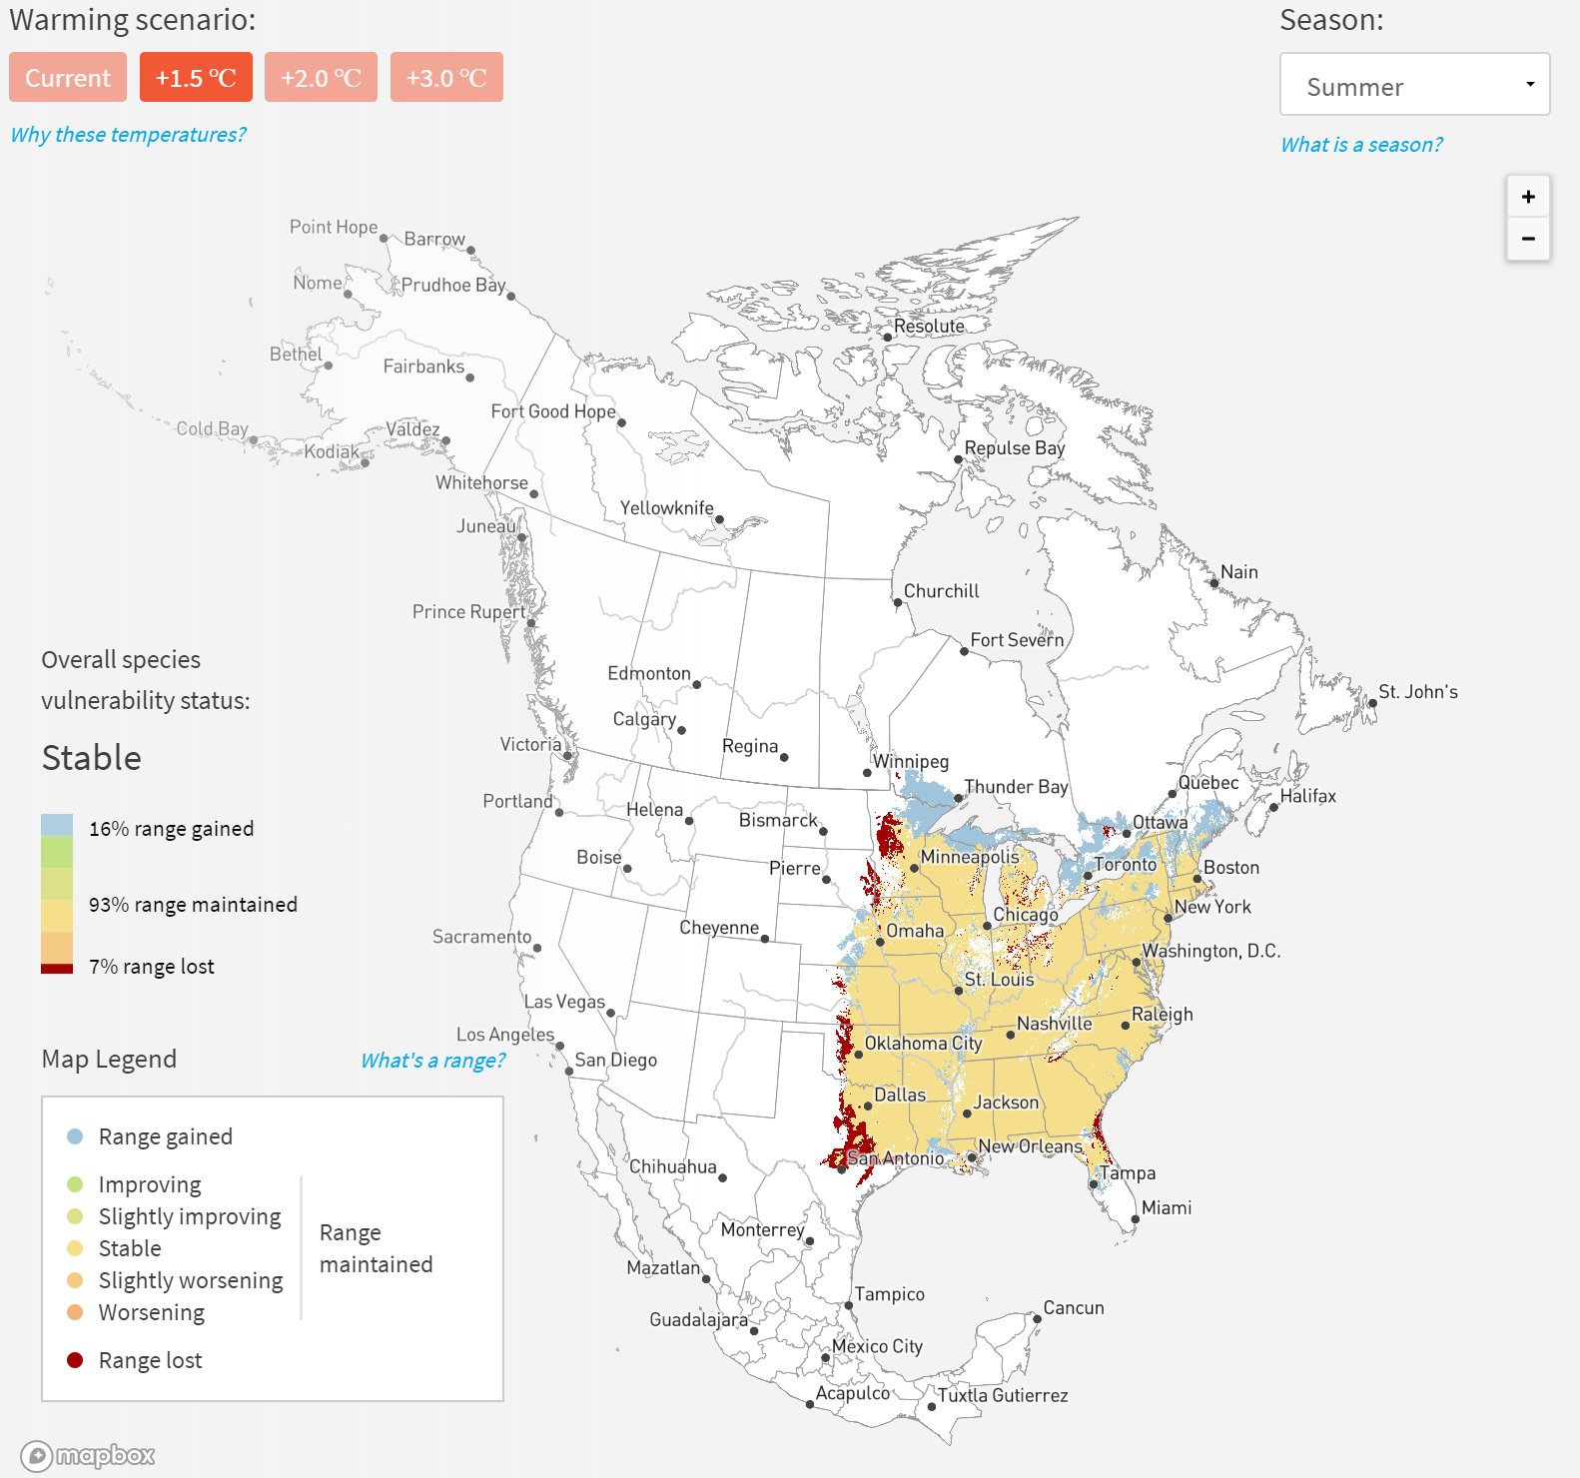
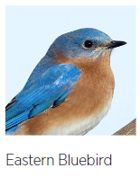
Notes:
So how do we go from our predictions (models) to information that is useful for volunteers?
This shows our online visualization for the Eastern Bluebird. All species predictions are publically available on the website (survivalbydegrees).

Slide 14
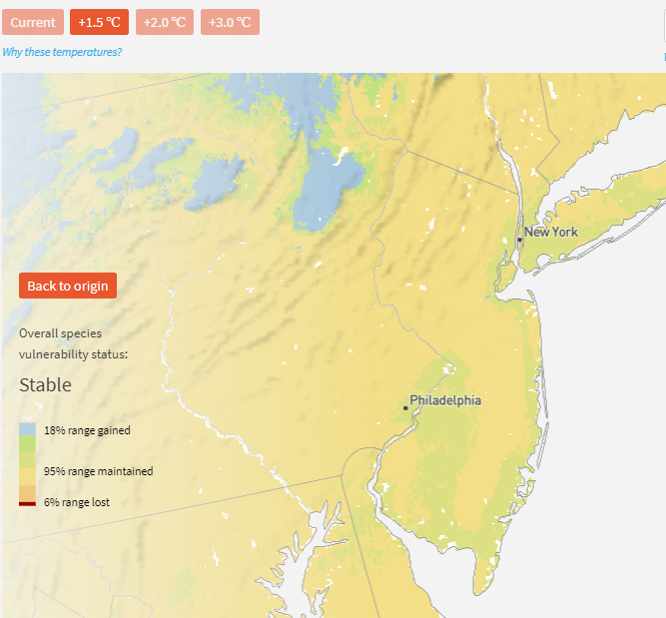
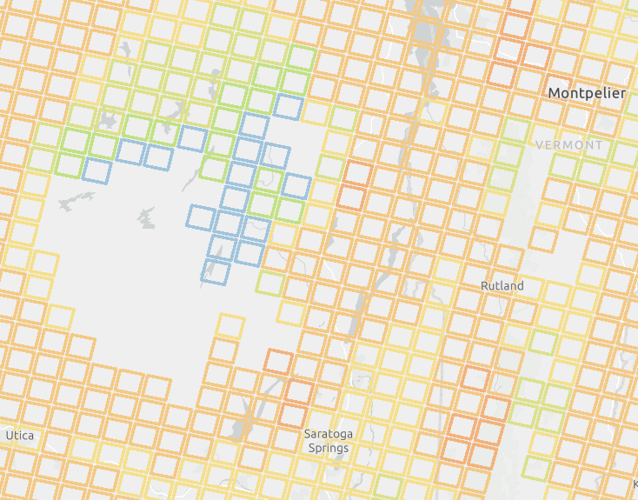
Notes:
Our model outputs gave us detailed information for each species on how each location may improve or worsen with climate change. We used that information to create a 10x10km grid of Climate Watch squares across North America. Each square has a value that indicates whether the climate and vegetation conditions in that area is predicted to improve, remain stable, or worsen for each species survival under climate change over the next several years.
This example shows the predictions for EABL around eastern PA in winter (blue = worsening, yellow = improving)
Volunteers help us verify whether these predications are accurate by monitoring for on the ground/real time changes in species occurrence in these areas.

Slide 15
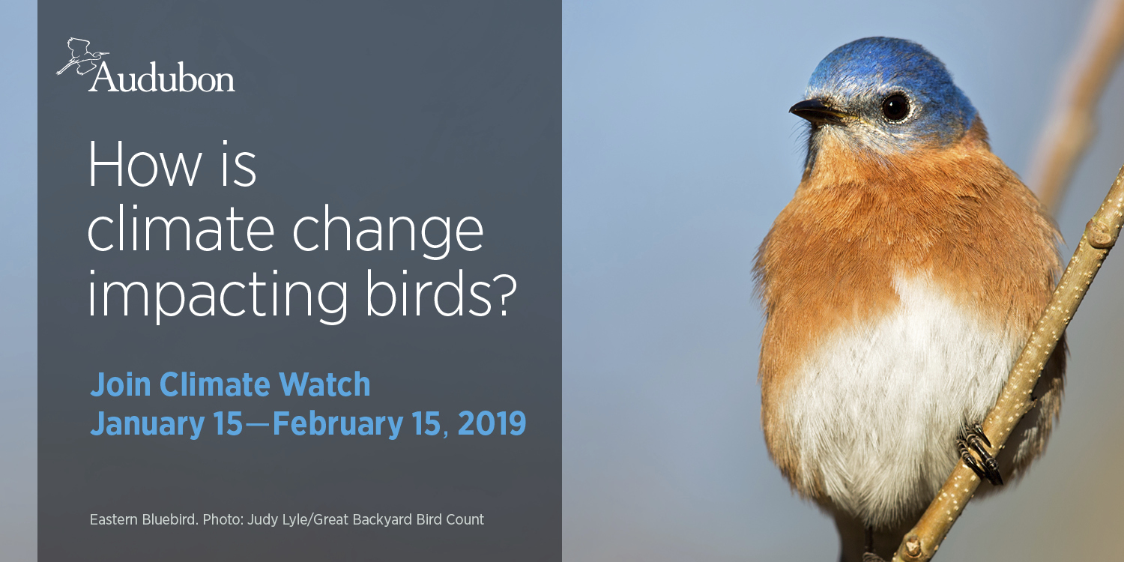
Notes:
Climate Watch occurs during two seasons. The winter survey time period runs from January 15 to Feb 15 each year. Volunteers are free to select a date within that time period to conduct a single square survey.

Slide 16
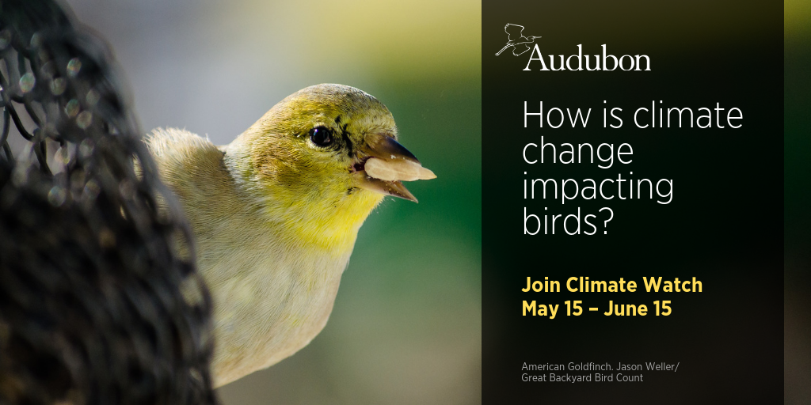
Notes:
The breeding season survey period for Climate Watch occurs May 15 to June 15 and volunteers can select a date of their choice for conducting surveys.

Slide 17
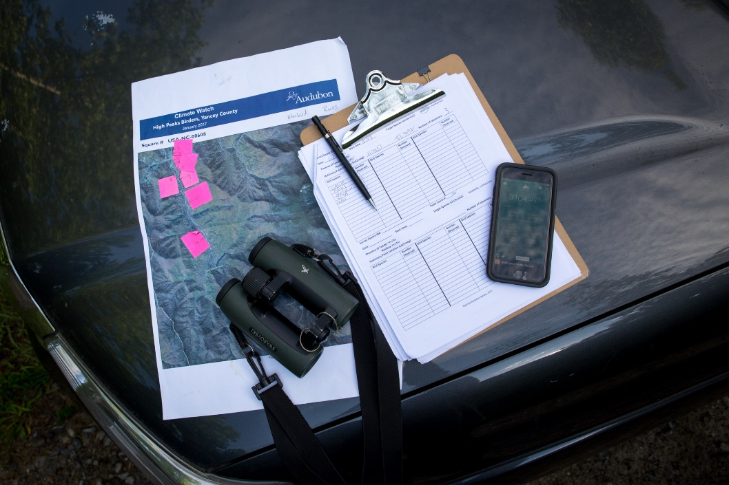
What is a participants role?
Identify the target species (or the desire to learn!)
Be available to conduct point counts for at least one day during count period
Communicate with the chapter coordinator to plan surveys
Submit data
Climate watch is open to birders of all levels!
Photo: Camilla Cerea
Notes:
Participants first pick a target species they want to help monitor. One they can identify or are willing to learn.
Participants should be available to monitor point counts for their target species for at least 1 day during the winter or summer count periods.
They communicate with their chapter coordinator to plan their surveys
All surveys for one square must be done within one morning by 12 noon local time, weather permitting.
They then submit their data!

Slide 18
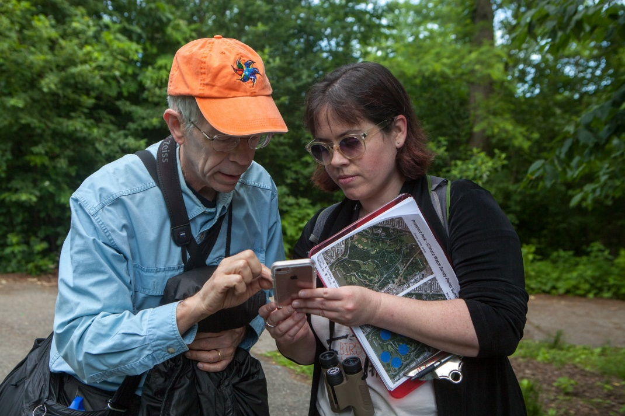
What is a coordinators role?
Recruitment/Engagement
Regional Coordinator- recruits local coordinators
Local coordinator- recruits participants
Pass on science information
Coordinate efforts and data submission
Point of contact with the national Climate Watch team
.
Photo: Camilla Cerea
Notes:
Another role for Climate Watch volunteers is to become a local coordinator or a regional coordinator. The local coordinator is responsible for recruiting local volunteers. If you are involved in an Audubon chapter or a bird club, this is great opportunity to work together to cover an area. For coordinated groups, we ask groups to aspire to cover 10 squares in your local area for a species.
Regional coordinators are responsible for recruiting local coordinators, perhaps within a state or other region.
Coordinators are responsible for the items on this list.

Slide 19
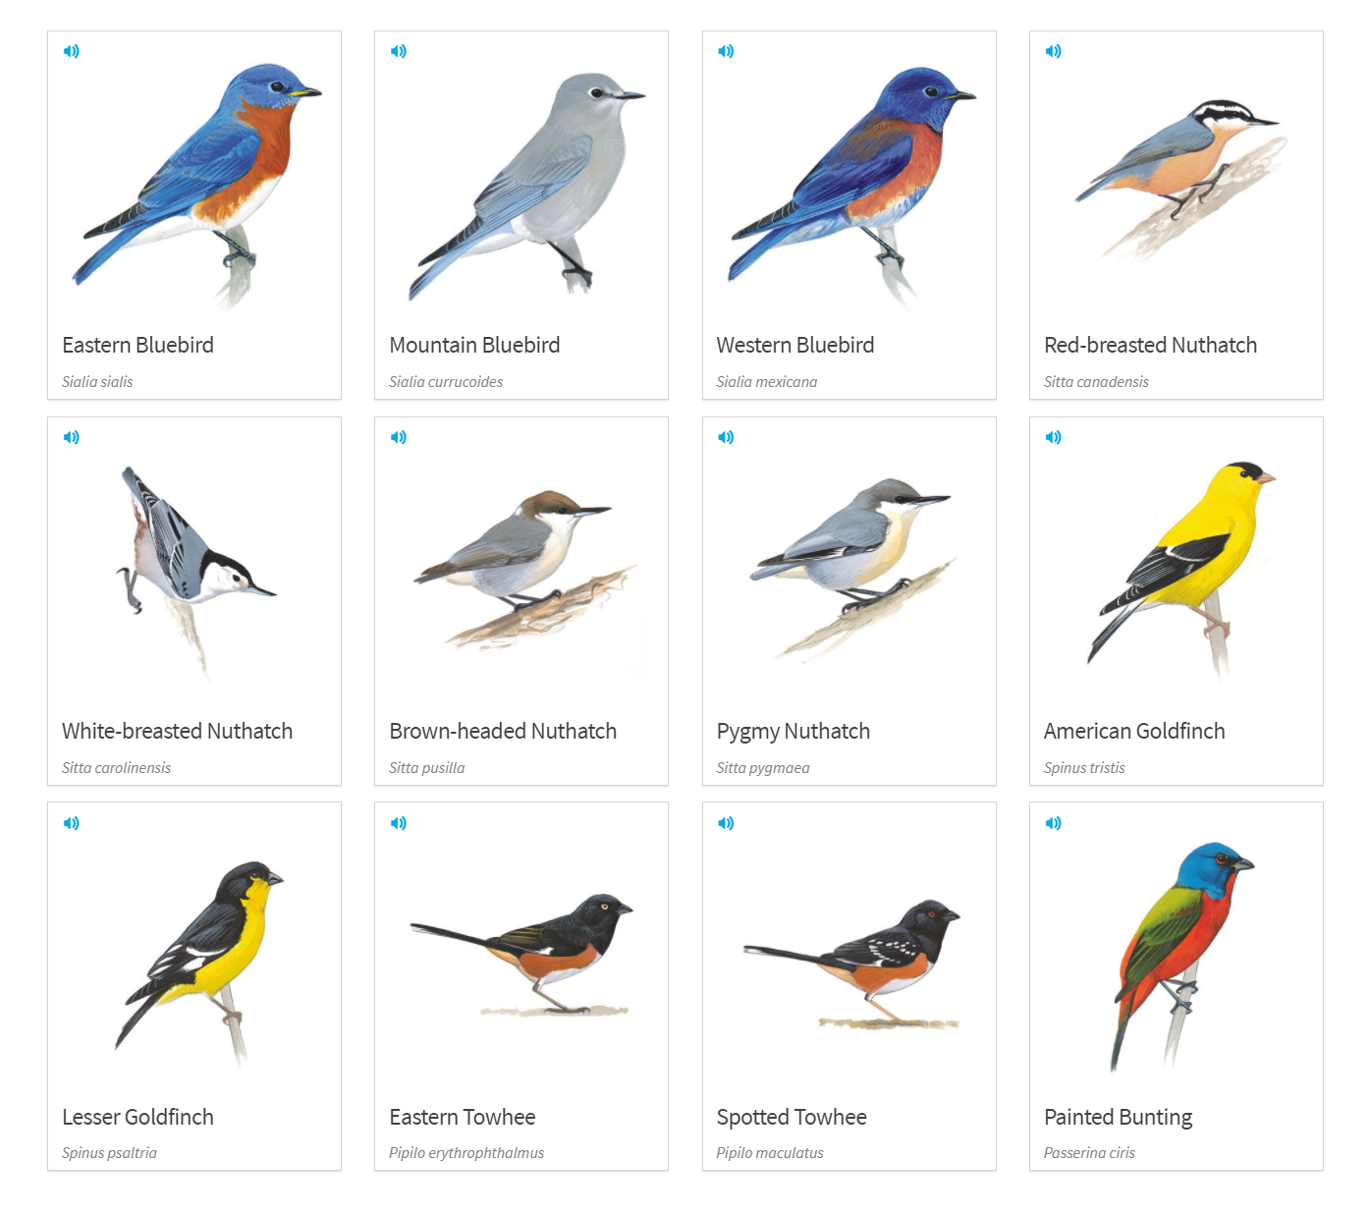
Climate Watch is open to birders of all levels!
Partner inexperienced and experienced birders
Partner inexperienced with more tech savvy
Coordinator can help select survey points
Study target species id marks and calls prior to survey
Notes:
Climate Watch does require that volunteers know how to identify at least one of the target species, but is open to birders of all levels.
New birders can be paired with experienced birds and learn on the go.
Those that do not want to use technology can be paired with those that do.
Coordinators can help out by selecting a square and survey points if individual volunteers do not know yet understand the protocol.
Of course it is important to study up beforehand to make sure volunteers know how to ID by sight and sounds. This is a good opportunity for coordinators to run a training tutorial in advance.

Slide 20
Climate Watch Protocol
Notes:
Let’s go over the Climate Watch protocol. The protocol is a list of the specific steps one must take in the field to monitor a bird for this project.

Slide 21
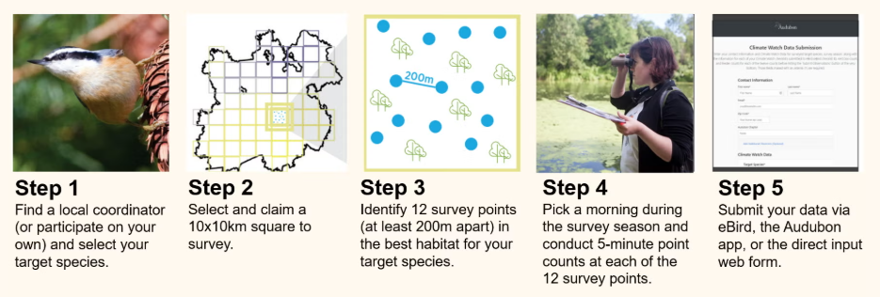
Climate Watch Protocol
Notes:
There are 5 steps in the protocol and I will go over each of them now. These 5 steps are available in a printable one page document on the climate watch website.

Slide 22
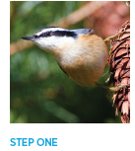
Step 1: Select Target Species
American Goldfinch
Lesser Goldfinch
Painted Bunting
Eastern Towhee
Spotted Towhee
Notes:
Step 1 – select a target species. The target species will drive the selection of where you monitor because you must go to the primate habitat for your target species.
We recommend that if you are new to climate watch, you focus on selecting just one species for which to monitor. There are some places in the US were it is likely you will see more than one target species in the same habitat. That is ok to do as well IF the habitat for both species is the same.

Slide 23

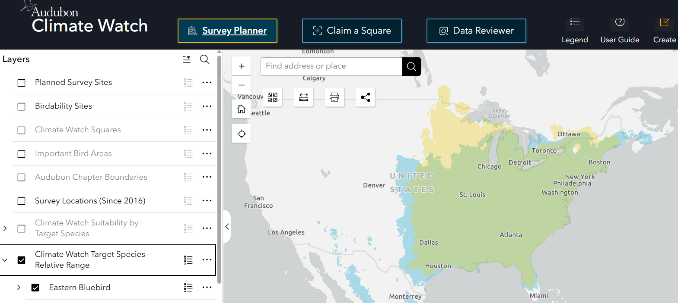
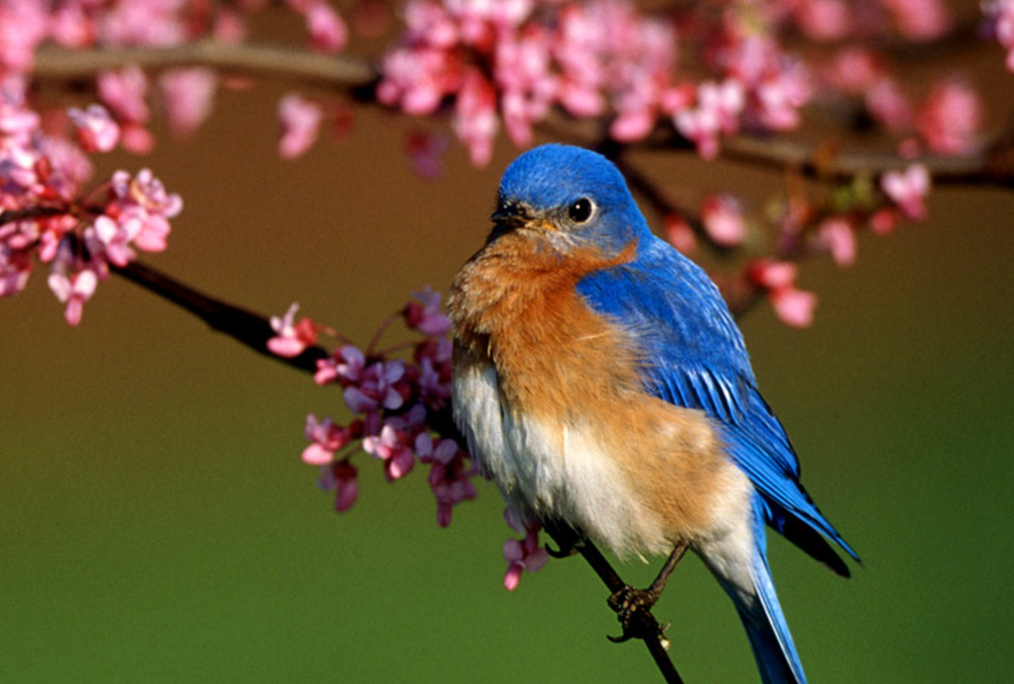
Step 1: Select Target Species
Online Resource: Getting Started Tutorial
Notes:
We provide online resources to help you select potential target species for where you are – the survival by degrees website has online animated maps for all of our target species and the online climate watch survey planner provides target species relative ranges so you can be sure to select target species that would be expected in the season and place that you plan to survey.

Slide 24
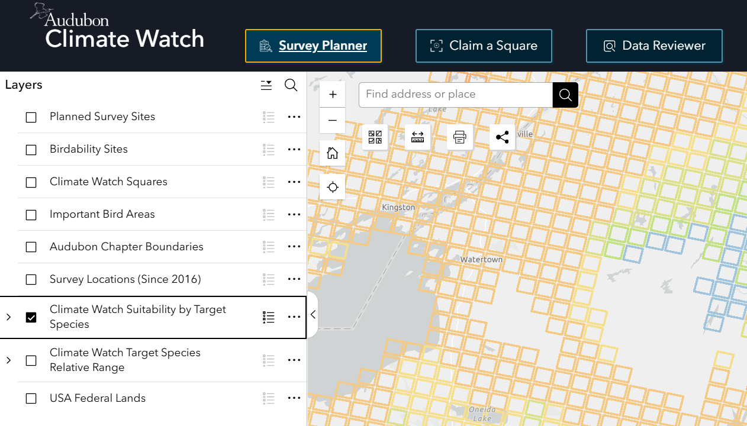
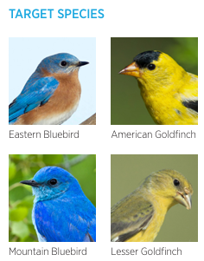
Step 1: Select Target Species
Online Resource: Getting Started Tutorial
Notes:
The Climate Watch survey planning tool also allows you to zoom in to see details of our modeled species suitability predictions in your area. Note that, in order to see the suitability predictions, you need to be in the Survey Planner tab, be zoomed into a local area, and have the Climate Watch Suitability by Target Species Layer turned on for the species of interest.
https://www.audubon.org/climate/survivalbydegrees
https://experience.arcgis.com/experience/df8e63644679430ba8777d67ec0618c9/page/Survey-Planner-

Slide 25
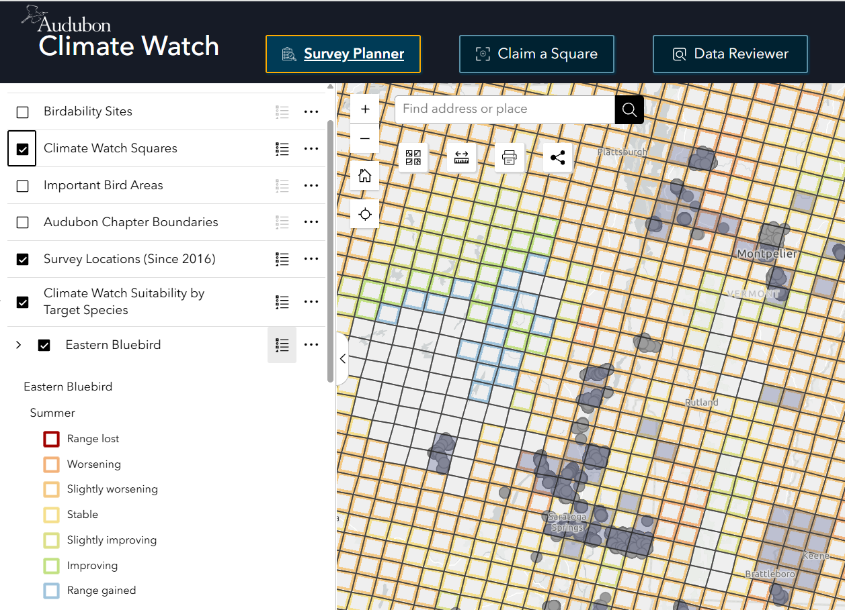
Step 1: Select Target Species
Online Resource: Getting Started Tutorial
Notes:
The online climate watch survey planner gives you the ability to see not only predictions, which are color coded, but where others are already monitoring (claimed squares are grey, dots indicate current/previous survey locations). Each square only needs to be covered once per season per species.

Slide 26
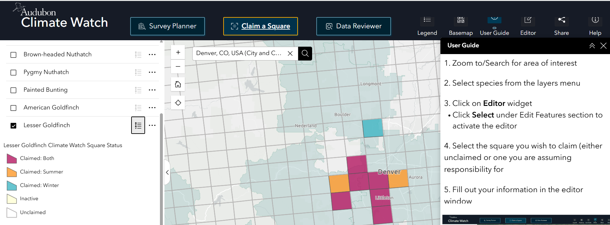
Step 2: Select & Claim Squares to Survey
Online Resource: Getting Started Tutorial
Notes:
Step 2: The next step is to decide which square or squares you want to monitor for your target species. In the Claim a Square tab of the online survey planner tool, once you've entered your address in the tool and selected the target species of interest, the online survey planner tool can help you decide by showing you squares that have already been claimed for a specific season (magenta for both, orange for summer, and blue for winter) for that species and those that are available. We encourage people to try and cover squares that have the most predicted change for a species (reds and blues when viewing the survey planner map), but accessibility and distance to you will be important factors as well.
Once you decide on your square or squares it will be important to you (or someone helping you) to “claim” your square through the online survey planning tool so that others know where you are working. Instructions on how to do this are available on our website, including a video tutorial that will walk you through this process.

Slide 27
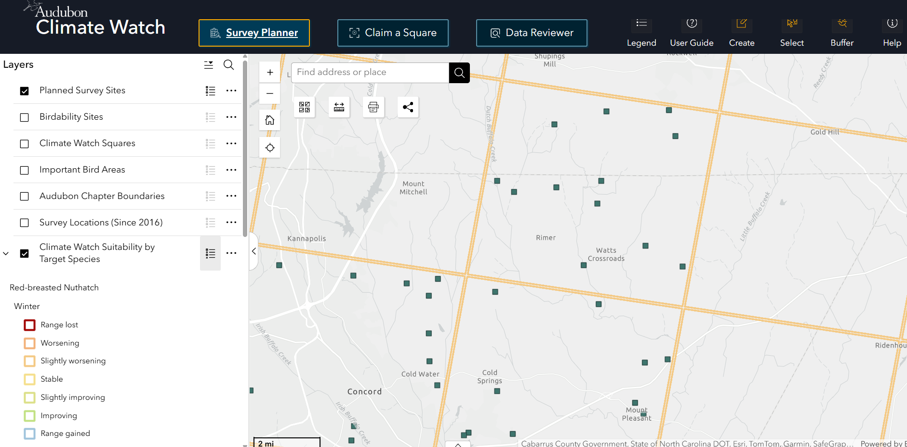
Step 3: Plan Survey Locations
Online Resource: Planning Your Survey Sites Tutorial
Notes:
Step 3: Once you have selected the square you want to survey the next step is to select the 12 points where you will conduct your surveys.
Each of these survey locations should be within your selected square, situated within the best habitat you are able to identify for the target species within the square, and at least 200 meters away from your other survey points. For reference, 200 meters is approximately 2 football fields or 2 Olympic swimming pools. This is because you’ll record all of the birds you detect within 100 meters of the survey point – keeping them at least 200 meters apart prevents double-counting any areas. More information about this step, including a video tutorial, is available on our website.

Slide 28
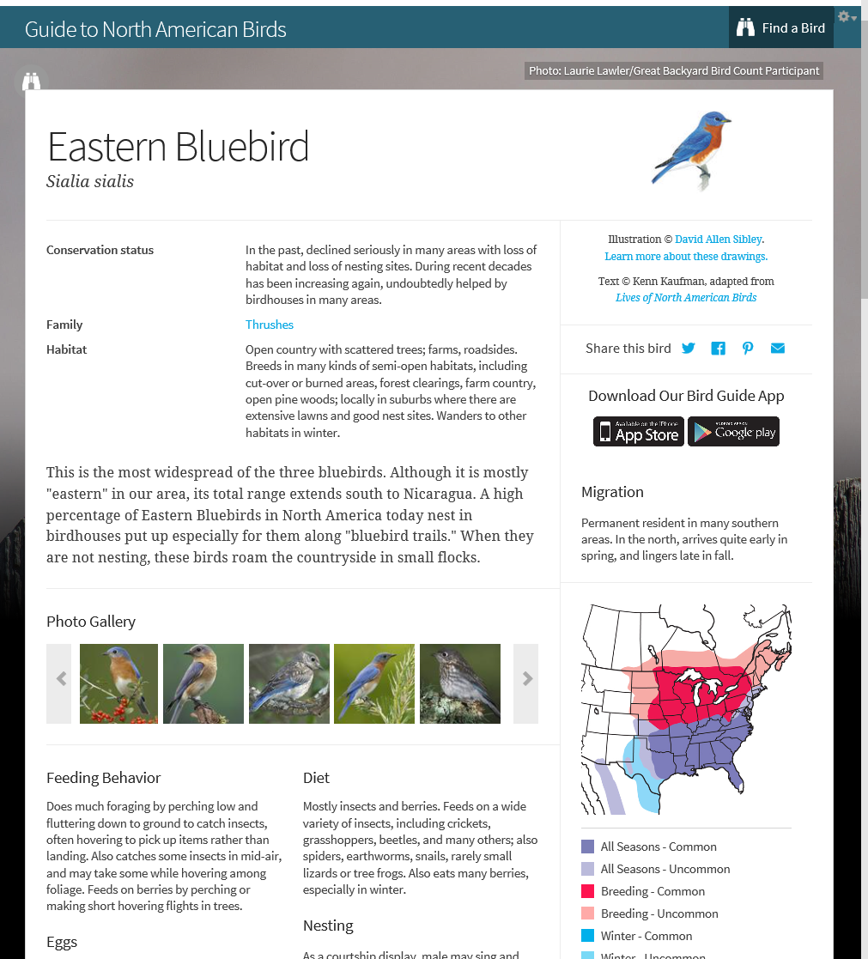
Step 3: Plan Survey Locations
Appropriate Habitat for Target Species
Climate Watch Coordinator
Local Knowledge
eBird species maps
Scout out sites
Audubon Field Guide app
Multiple target species?
Online Resource: Planning Your Survey Sites Tutorial
Notes:
You can use a number of resources to determine where the best habitat is for your target species. [read list]
As mentioned before, if you live in an area where appropriate habitat is present for more than one species at a time, you can conduct simultaneous surveys for more than one target species. This will depend on your local area and local coordinator or group goals.

Slide 29
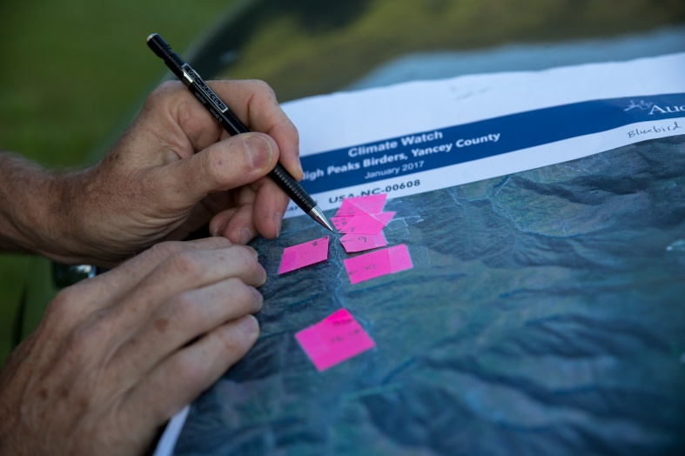
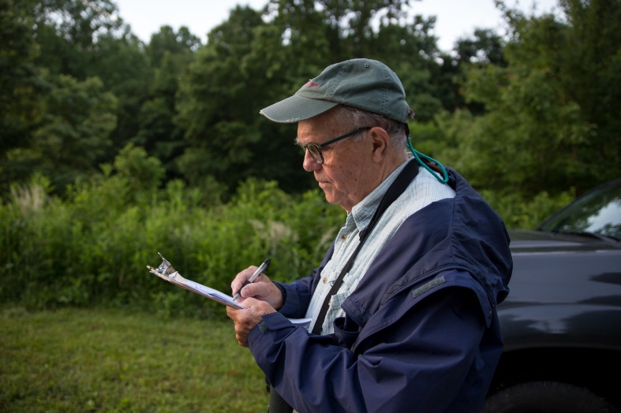
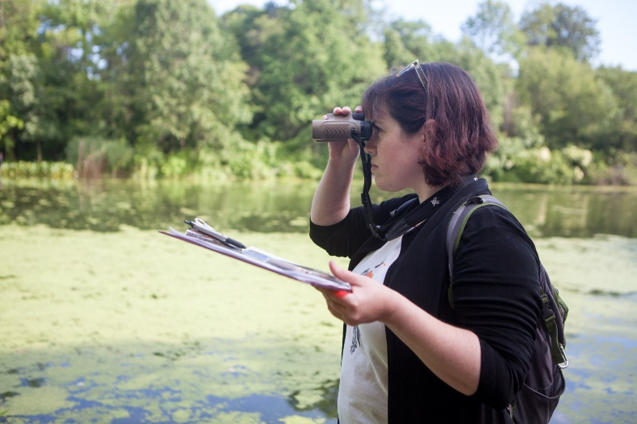
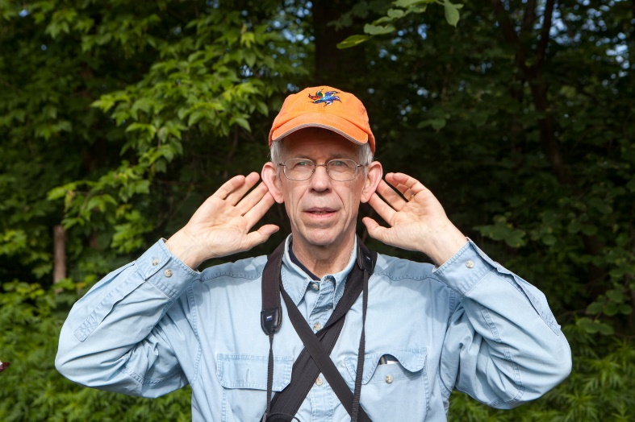
Step 4: Conduct Point Counts
Conduct 12, 5-minute point counts within a square​
If using eBird record all birds seen or heard, and numbers of each, within 100 m of your point location (that you are able to identify)​, and don't select eBird hot spots for locations
If using the Audubon mobile app record any target species and numbers​ within 100 m of points
Record presence of nest boxes or feeder stations​
Keep a separate checklist for each point
Conduct point counts before noon when possible, but afternoon surveys are an option if weather conditions are suboptimal. ​
On average, surveying 12 points takes 3 hours (2-6 hours)
Online Resource: Conducting Surveys Tutorial
Photos: Camilla Cerea
Notes:
Step 4: Conduct your 12 point counts as described here.
There is a full written manual with much more detail on these 5 steps available on the Climate Watch website, as well as a video tutorial that walks you through this step.

Slide 30
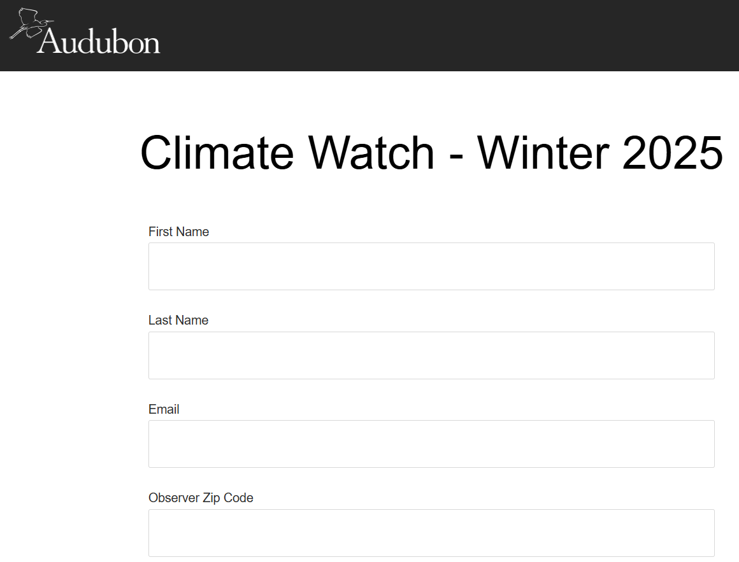


Step 5: Submit Your Climate Watch Data
Online Resource: Submitting Data Tutorial
Three options:
Use eBird (share your eBird checklist URLs through our Climate Watch submission portal)
Use the Audubon mobile app
Enter data manually via the online Climate Watch Form
Notes:
Step 5: Submit your data!
There are three methods for submitting data for Climate Watch:
1 – Use eBird mobile or the eBird web version to record your data. Then collect all of your eBird checklist IDs and submit through Audubon’s Climate Watch portal.
2 – Use Audubon’s mobile app.
3 – if you don’t have a smartphone, you can also enter the data manually via our online web form
Again, our website and the Climate Watch manual has much more detail on these 3 data submission options, as well as a video tutorial that walks you through this step.

Slide 31


audubon.org/climate-watch
Online Resource: Submitting Data Tutorial
Notes:
We have detailed instructions on how to submit data via any of these three ways on the Climate Watch website. If you visit the main page, click on "Submit Your Data to Climate Watch" and you can select the way you will be submitting data to get step by step instructions and links to do so. We will go through the first two methods quickly here, which are our recommended methods.

Slide 32


If using eBird to record data you will share your checklist IDs through our online Climate Watch Data Submission portal.
Online Resource: Submitting Data Tutorial
Notes:
If you use eBird to collect your data, we ask that you take the additional step to then copy and paste your eBird checklist IDs into the Audubon portal so that we can use the data in our analysis. When you submit your data through the portal you will receive an onscreen confirmation and an email confirmation. If you do not receive both of these, please contact us at climatewatch@audubon.org.

Slide 33

You can use Audubon’s mobile app to record your Climate Watch observations and save your checklists.
Note: The Audubon app's Climate Watch checklist capability is available only during the count period, so do not delay submitting your data this way.
You can download the app here: https://www.audubon.org/app
Online Resource: Submitting Data Tutorial
Notes:
Use Audubon’s mobile app to record your Climate Watch observations and save your checklists.
Note that the Audubon app's Climate Watch checklist capability is available only during the count period, so do not delay on submitting your data this way.
You can download the app here: https://www.audubon.org/app
If you use the Audubon mobile app, once you save your data, Audubon has the data!

Slide 34
Climate Watch Resources

Slide 35


2019 Survival By Degrees Climate Change Report
https://www.audubon.org/climate/survivalbydegrees
Notes:
Audubon’s Birds and Climate Change Report is the best place to see high-level views of our predictions for range shifts for over 300 under different emissions scenarios. Includes information on how their ranges are predicted to shrink, shift, or expand and can show you long-term trends predicted for your area.

Slide 36






Climate Watch Resources
Climate Watch Website
audubon.org/climatewatch
Notes:
To get a more detailed view of the predictions for your area and to learn more about the details of participating in Climate Watch you van visit the Climate Watch website at Audubon.org/climatewatch. Here you will find a number of resources that can help you, your local coordinator, and others learn how to participate in Climate Watch most effectively in your area.
The first and most basic resource is the one-page Protocol Overview. This is a great resource to share with people who might be interested in participating – not necessarily enough information that they can read this one page and head off into the field but should be a good resource for people to decide if they want to participate – and even though the protocol is more complex than some of our other community science programs we do want to encourage as many people as possible to get involved.

Slide 37

Engagement Toolkit
Videos
Posters and Flyers
Sample newsletter content
Press release template
Social media content
Webinar materials
Letters to elected officials templates
Recruitment guide
Notes:
Coordinators and volunteers are provided with lots of materials to try and engage more people in your area. These items are available through the coordinators web page.

Slide 38

Recruiting volunteers/participants
Participants in other citizen/community science programs
Facebook and other social media channels
Master naturalist programs
Local birding groups, garden clubs, land trusts
State Website (e.g. http://nc.audubon.org/news/watching-nuthatches-0)
Audubon toolkit- recruitment guide
Notes:
Here is a list of ways in which Climate Watch coordinators have recruited new volunteers.

Slide 39
We like the fact that we're contributing, even in a small way, to a scientific effort that will, hopefully, benefit the birds we love to watch
Climate watch volunteer
Notes:
An early volunteer provided this feedback about the program.

Slide 40

Notes:
Since 2016, dedicated Climate Watch volunteers have traversed habitats across the U.S. to look for bluebirds and nuthatches in both summer and winter. Here in Audubon’s Climate Watch Reporting tool, we can start to see where Climate Watch surveys are being conducted, and the species that are being found.
Check out this interactive tool here
http://www.audubon.org/climate-watch-results
Currently this web tool covers years 2016-2020 data collected. We plan to update the data soon.

Slide 41


Notes:
In the first peer-reviewed study of its kind, participants in Audubon’s Climate Watch program helped determine the ongoing impact of climate change to bluebirds and nuthatches.
Saunders, S. P., N. L. Michel, B. L. Bateman, C. B. Wilsey, K. Dale, G. S. LeBaron, and G. M. Langham. 2020. Community science validates climate suitability projections from ecological niche modeling. Ecological Applications 00(00):e02128. 10.1002/eap.2128
The journal Ecological Applications published a final version of a study from National Audubon Society scientists demonstrating that climate change is causing a measurable shift of birds’ ranges during winter and breeding seasons. Years of bird observations gathered by hundreds of volunteer participants in Audubon’s Climate Watch community science program confirm projections made earlier by Audubon that rising temperatures and changing precipitation patterns will likely result in the colonization of new territories by North American birds.
Climate Watch volunteers have confirmed the accuracy of Audubon’s climate projections, which show that two-thirds of North American birds are at risk of extinction by the end of this century,” said Brooke Bateman, PhD, Audubon’s senior climate scientist and lead author of Survival by Degrees: 389 Bird Species on the Brink, a report published in October 2019.
From Abstract - Climate change poses an intensifying threat to many bird species and projections
of future climate suitability provide insight into how species may shift their distributions in
response. Climate suitability is characterized using ecological niche models (ENMs), which
correlate species occurrence data with current environmental covariates and project future distributions
using the modeled relationships together with climate predictions. Despite their
widespread adoption, ENMs rely on several assumptions that are rarely validated in situ and
can be highly sensitive to modeling decisions, precluding their reliability in conservation decision-
making. Using data from a novel, large-scale community science program, we developed
dynamic occupancy models to validate near-term climate suitability projections for bluebirds
and nuthatches in summer and winter. We estimated occupancy, colonization, and extinction
dynamics across species’ ranges in the United States in relation to projected climate suitability
in the 2020s, and used a Gibbs variable selection approach to quantify evidence of species–climate
relationships….. More broadly, our work highlights the
value of community scientist observations for ground-truthing projections from statistical
models and for refining our understanding of the processes shaping species’ distributions
under a changing climate.

Slide 42

Initial Occupancy
Notes:
This table shows results from the first analysis that these 7 species are all occupying sites that are climate suitable currently in summer and winter.

Slide 43

Probability of Extinction
Notes:
This table shows whether each species are leaving sites (extinction at that location) that are worsening in climate suitability.

Slide 44

Colonization
Notes:
This table shows results for “are species moving into sites that are projected to be climate suitable?”

Slide 45

Thank you for participating in the Climate Watch program!
If you have any questions, please contact the Climate Watch team at
climatewatch@audubon.org
Website and resources available at audubon.org/climatewatch

